Slide 1

NIPS2017:Recursive sampling for the Nystrom method
汇报人：王思为
2017.12.2
Poster will be shown in New England Machine Learning Day May 12, 2017

Slide 2
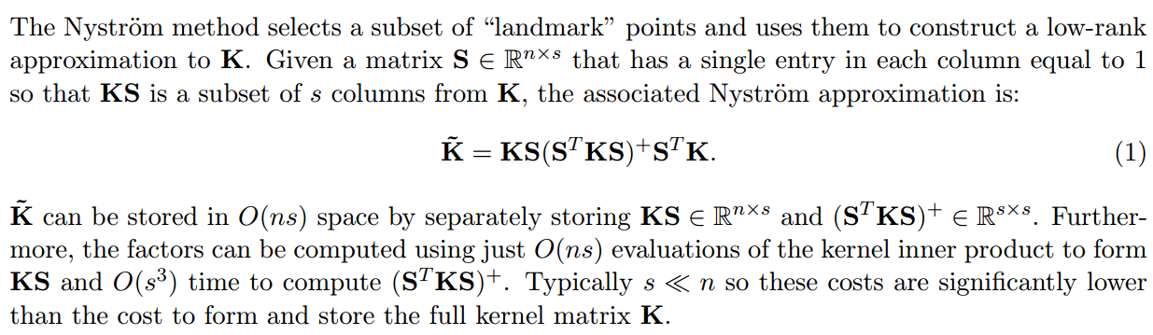
Standard Nystrom Method
01
Nystrom method

Slide 3
Landmark selection
01
Transformed representation
The basic way is to selects p representative data points as the landmarks and compressive the data size.
02
The way to choose landmarks
Random ,the k-means centroids, k-means ++,leverage-score based selection
Chen, X., & Cai, D. (2011). Large scale spectral clustering with landmark-based representation. AAAI Conference on Artificial Intelligence (pp.313-318). AAAI Press.

Slide 4
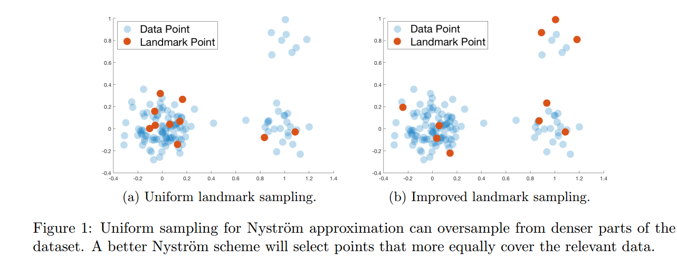
Drawbacks of uniform sampling

Slide 5
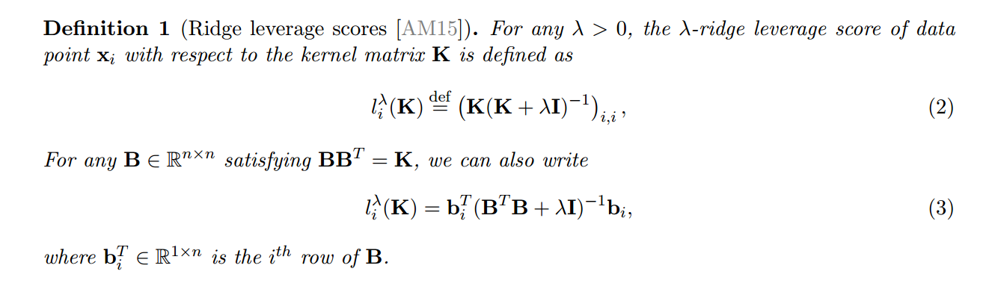
Definition of Ridge leverage scores

Slide 6
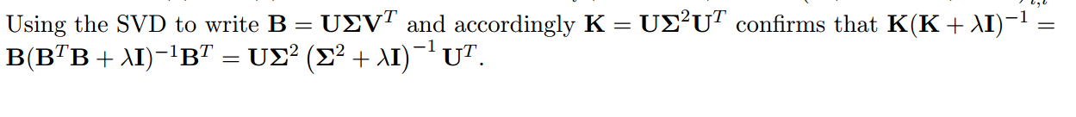
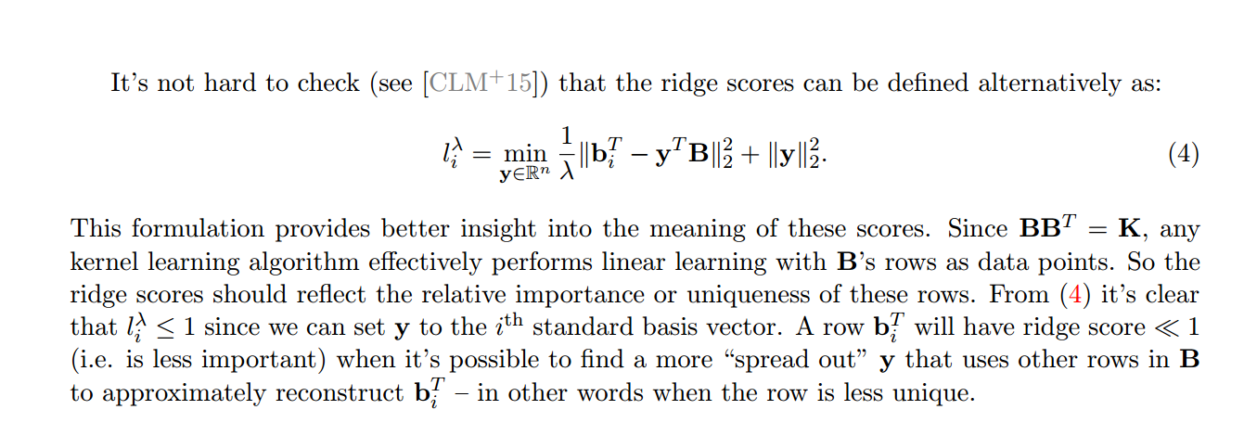

Slide 7
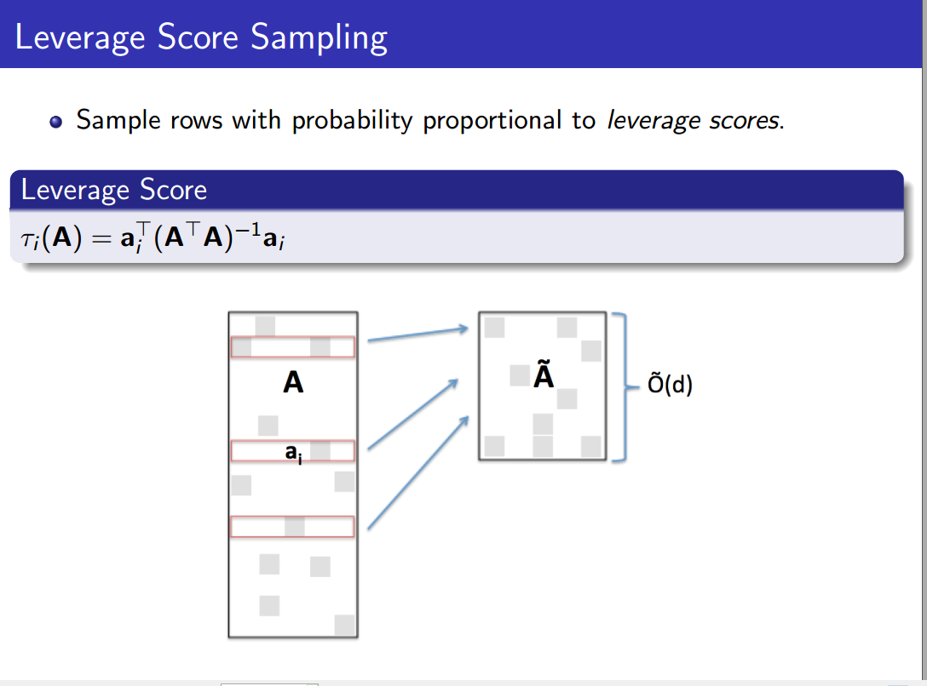

Slide 8
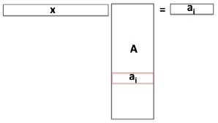
What is the leverage score?
How easily a row can be reconstructed from other rows
2
2
min ||x||
= τi(A).
ai has component orthogonal to all other rows: x = ei, x
= 1.
2
There are many rows pointing ‘in the direction of’ ai: x is well spread
and has small norm.

Slide 9
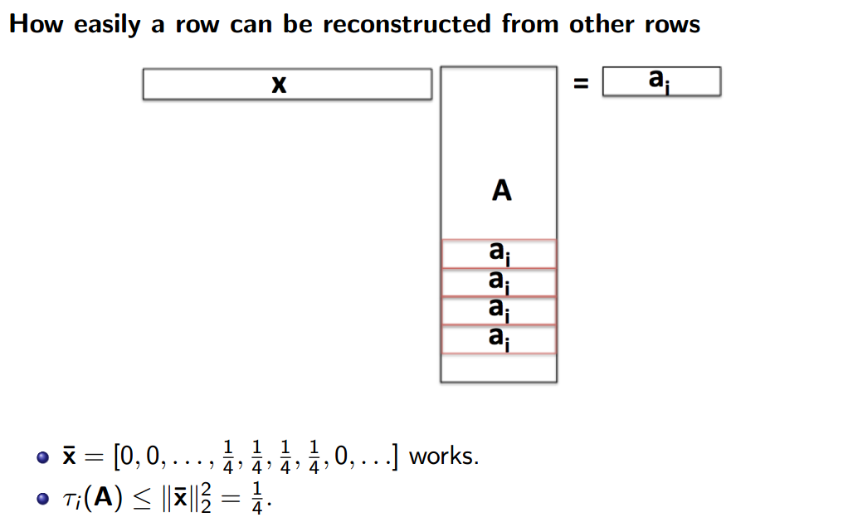

Slide 10
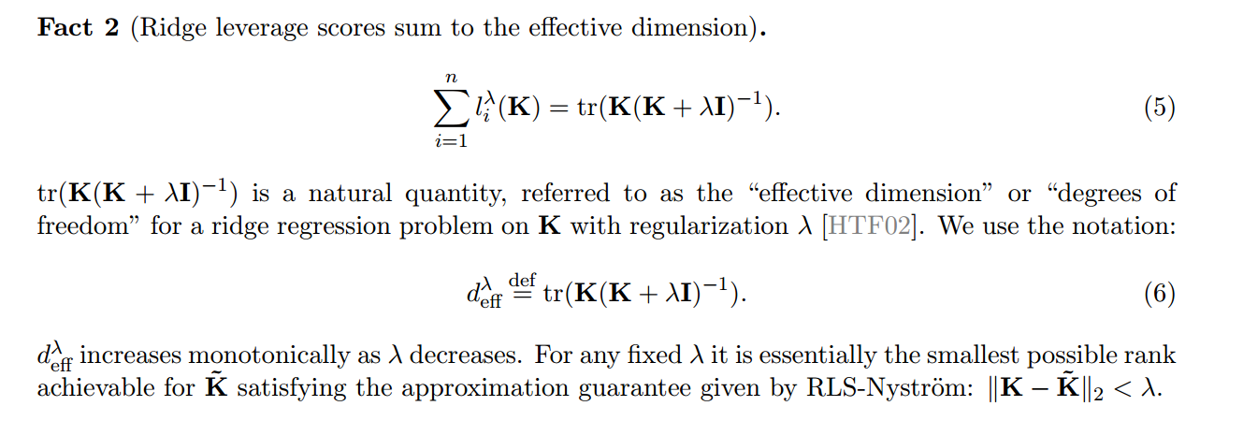

Slide 11
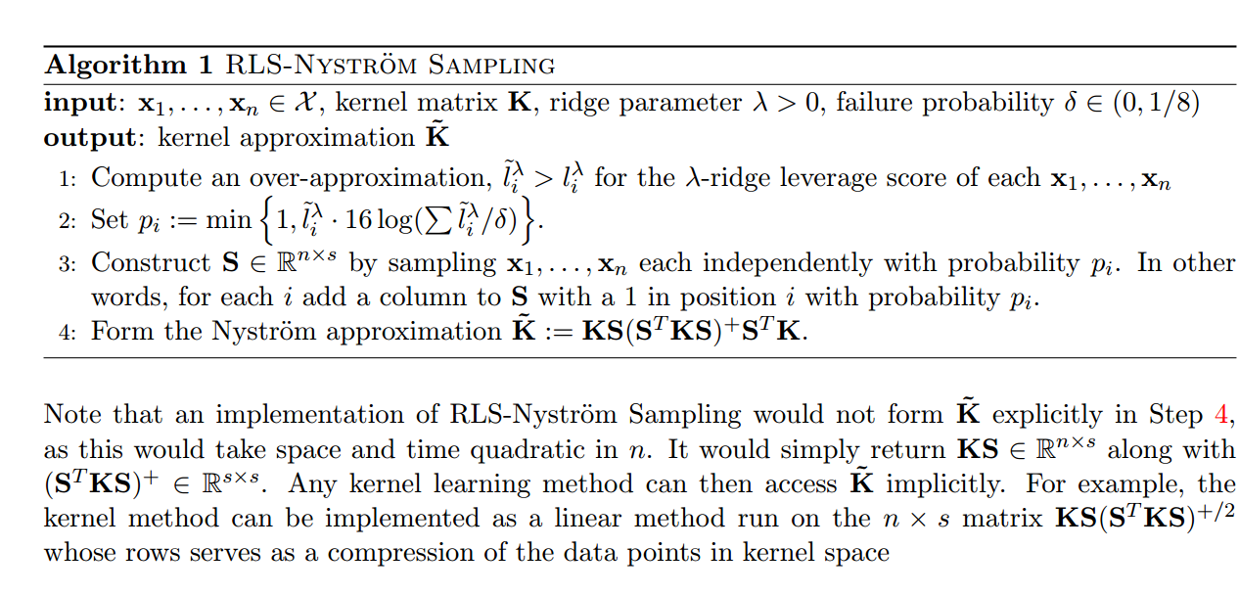

Slide 12
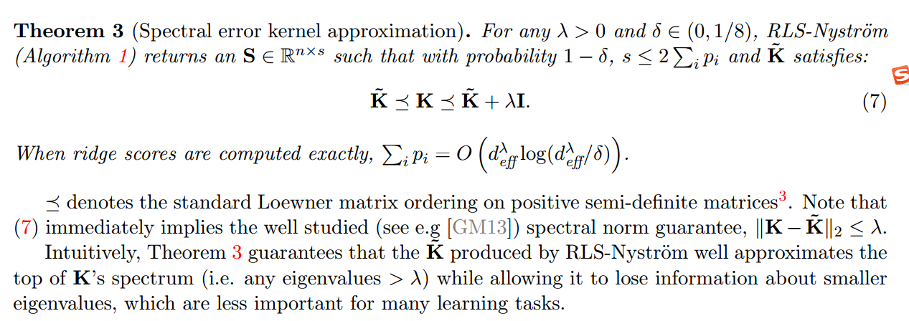

Slide 13
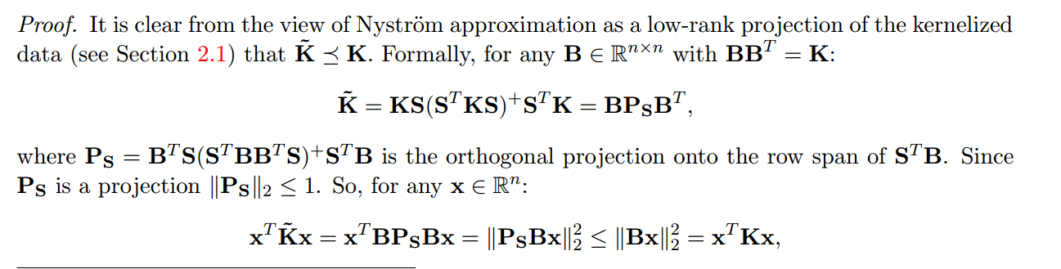

The upper result shows that

Slide 14
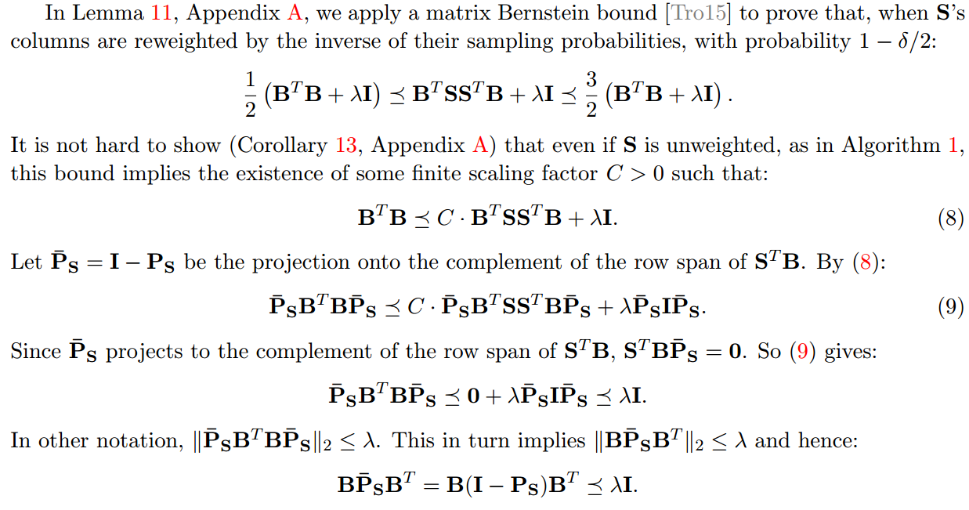

Slide 15
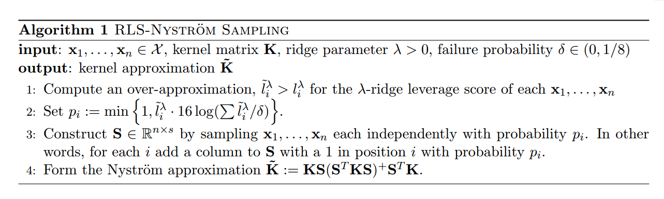

Slide 16
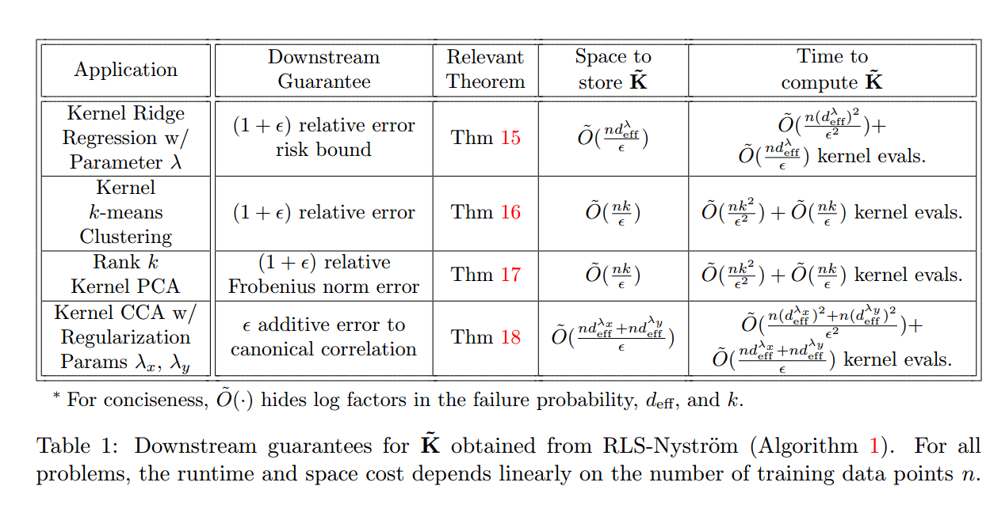

Slide 17
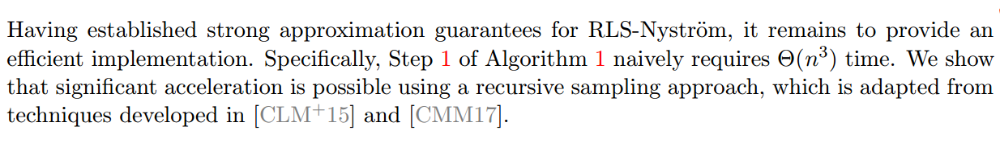
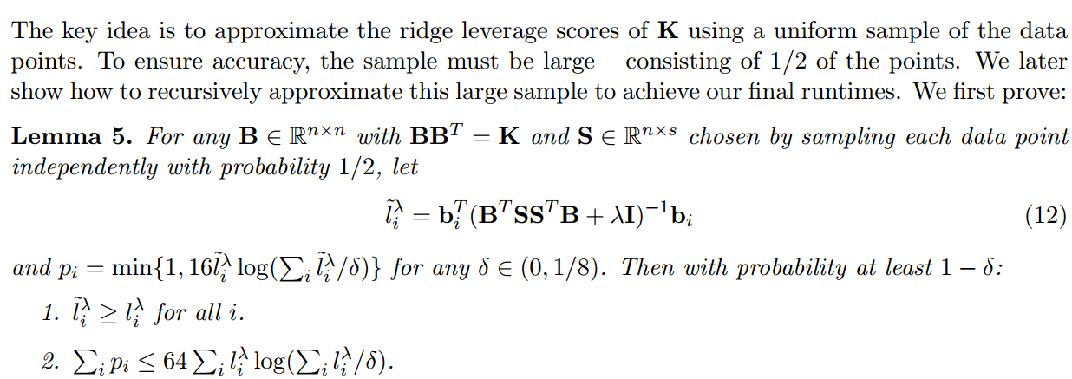
How to improve the algorithm1?

Slide 18
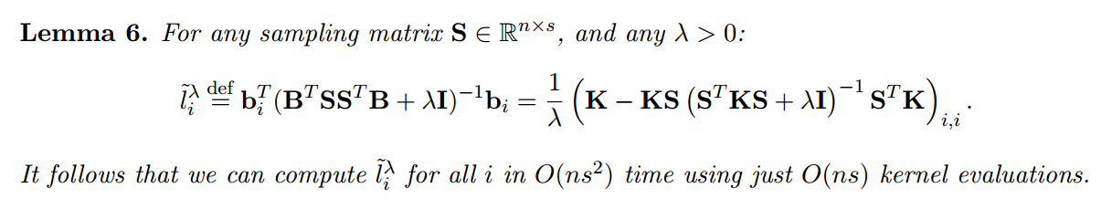

Slide 19
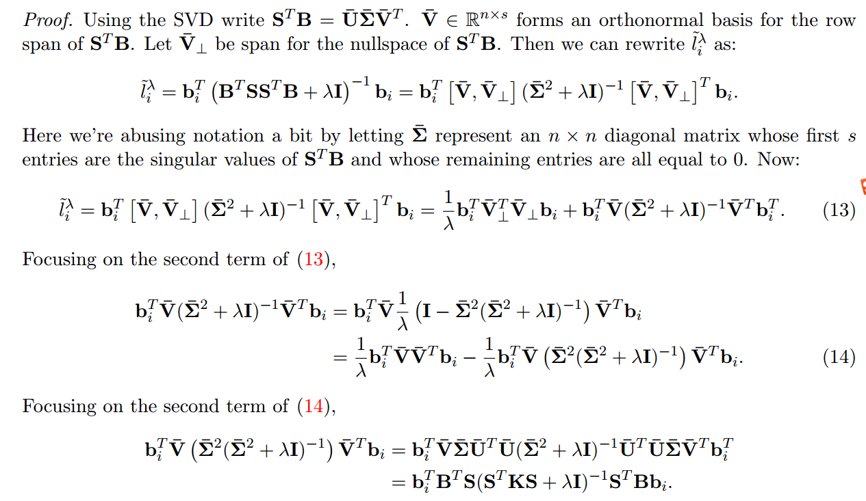

Slide 20
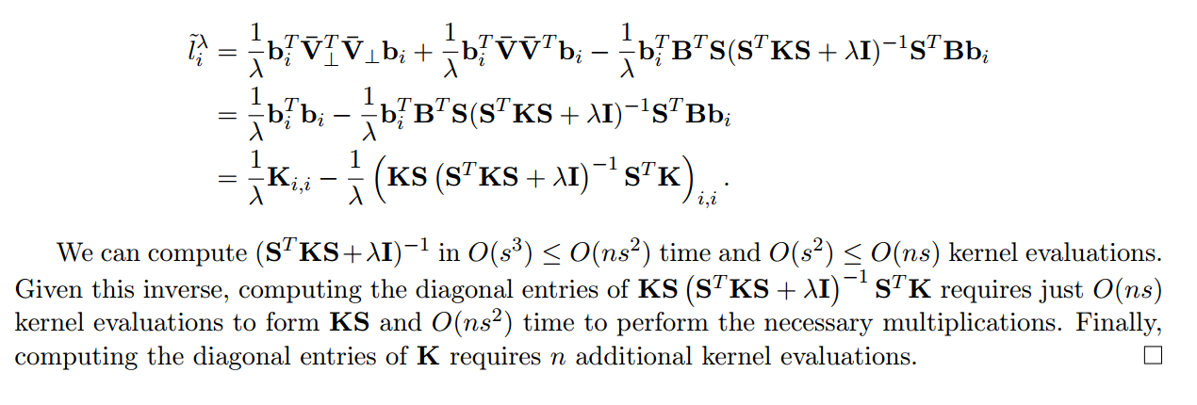

Slide 21
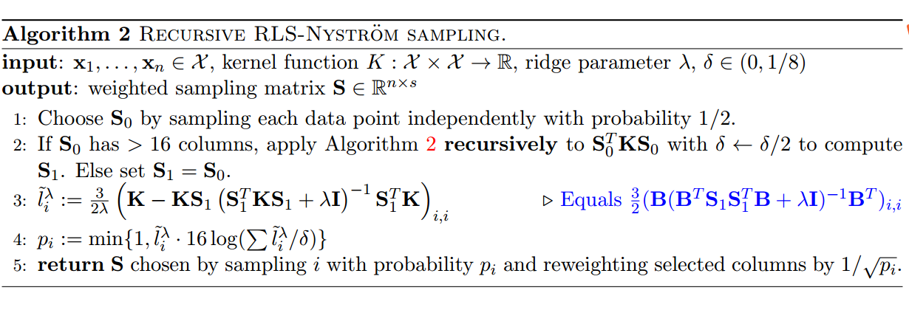

Slide 22
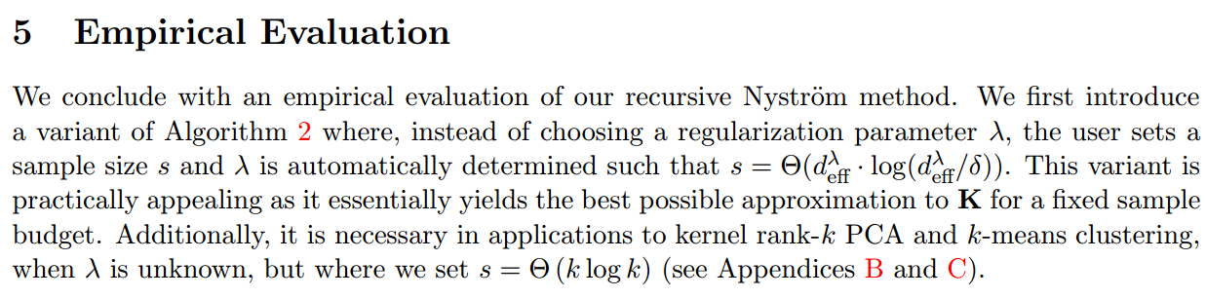

Slide 23
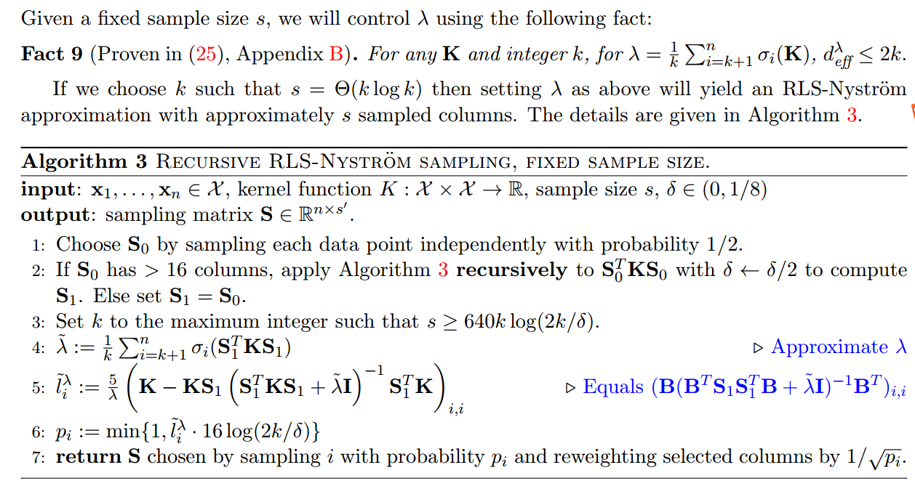

Slide 24
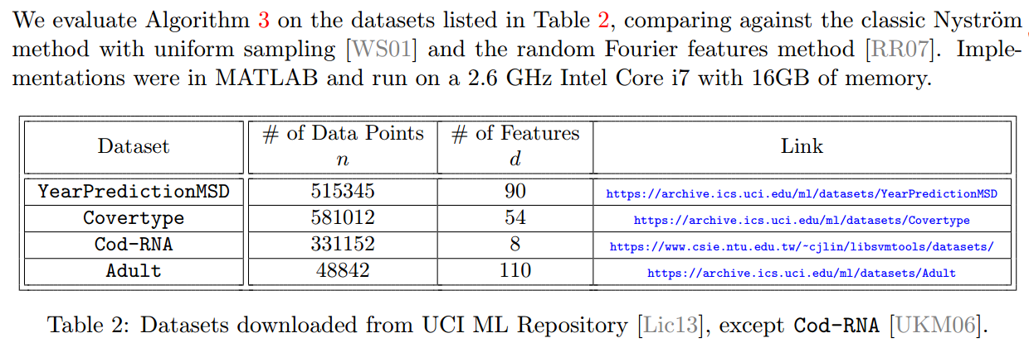

Slide 25
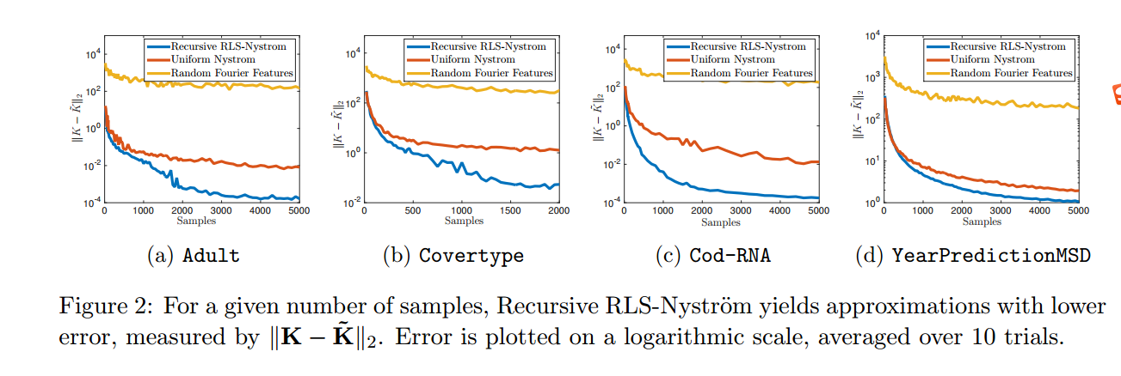

Slide 26
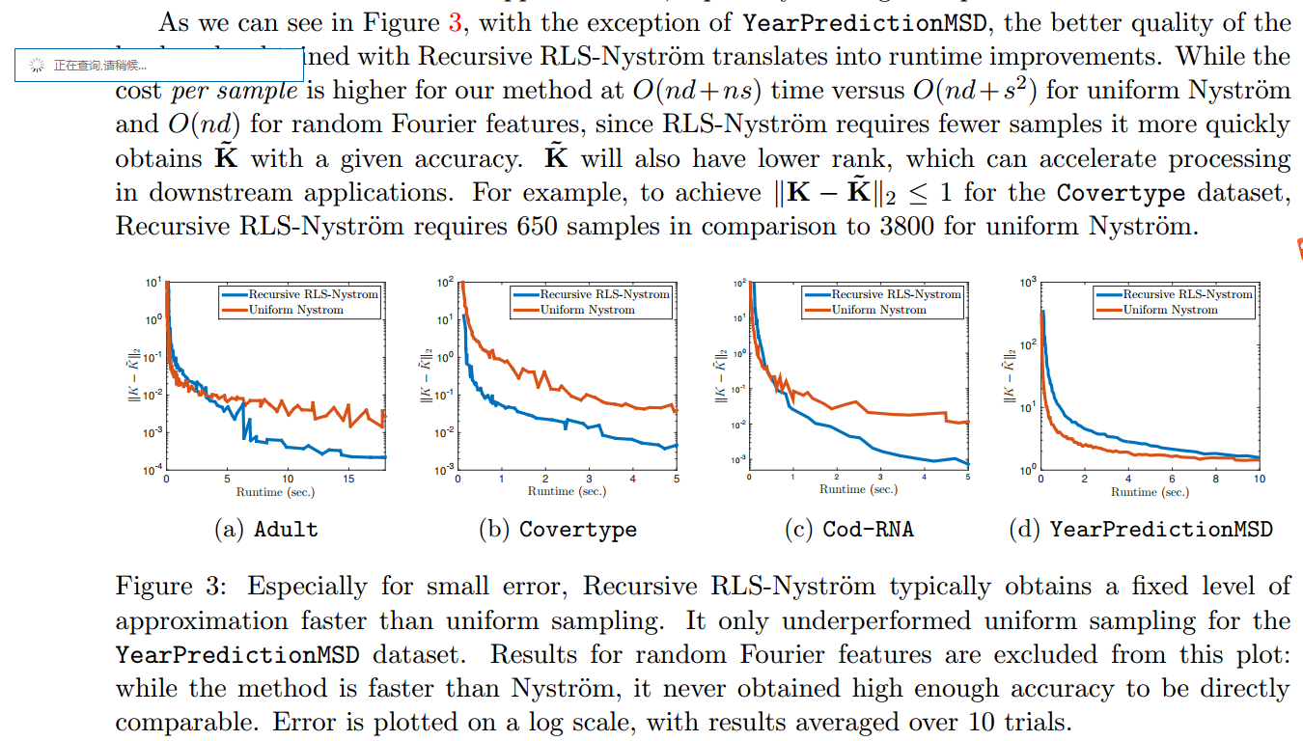

Slide 27
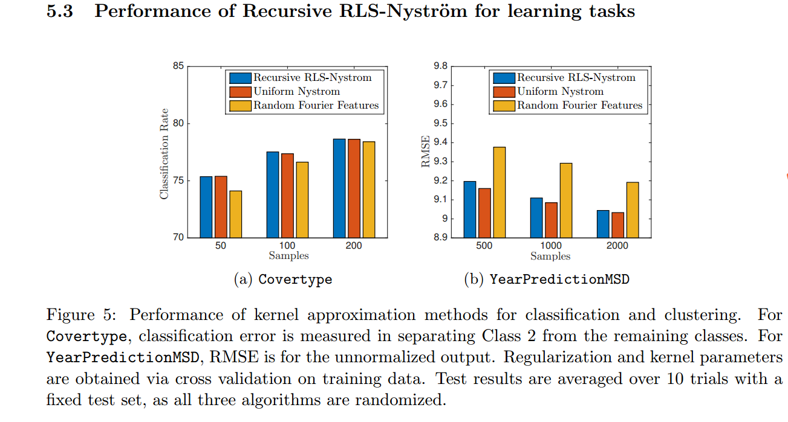

Slide 28
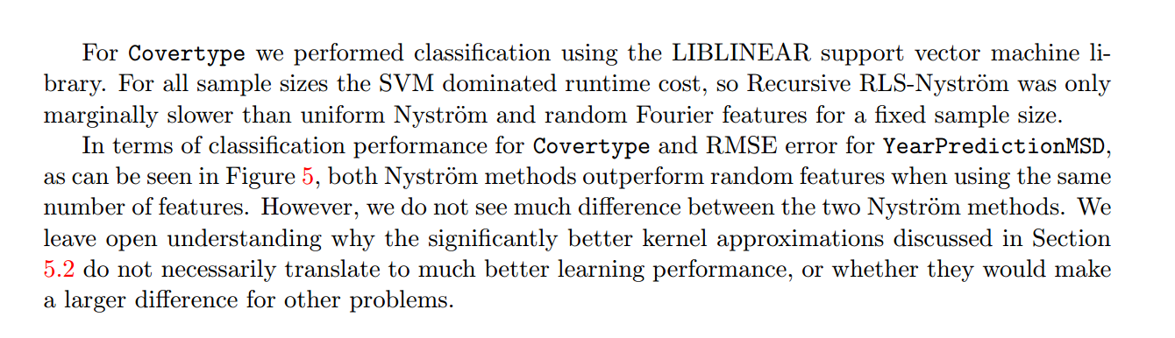

Slide 29
THANKS

